Slide 1
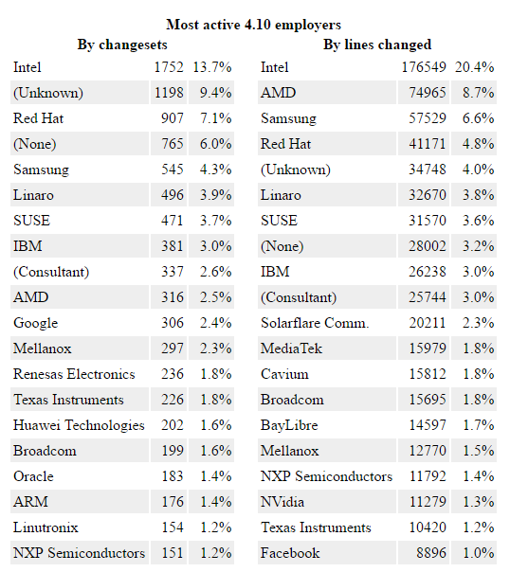
Linux Kernel Report 03/2012
Source: The Linux Foundation
Linux Kernel Report 09/2013
Source: The Linux Foundation
Linux Kernel Report 09/2015
Source: The Linux Foundation
Linux Kernel 4.2
Source: LWN.net
Linux Kernel 4.4
Source: LWN.net
Linux Kernel Report 09/2016
Source: The Linux Foundation
Linux Kernel 4.10
Source: LWN.net

